Slide 1
Making an object move in and out of slides
Blair Button

Slide 2
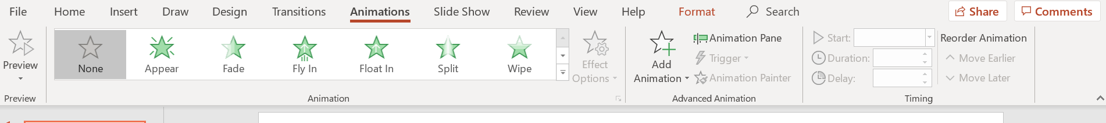
1. Select the textbox or picture and then open the “animations” tab.

Slide 3
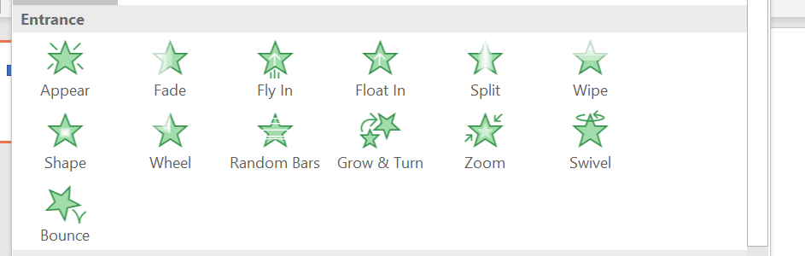
2. Select an “entrance” option to choose how the object comes into the slide. This way, the information can appear on the slide at the same time as you present it.

Slide 4
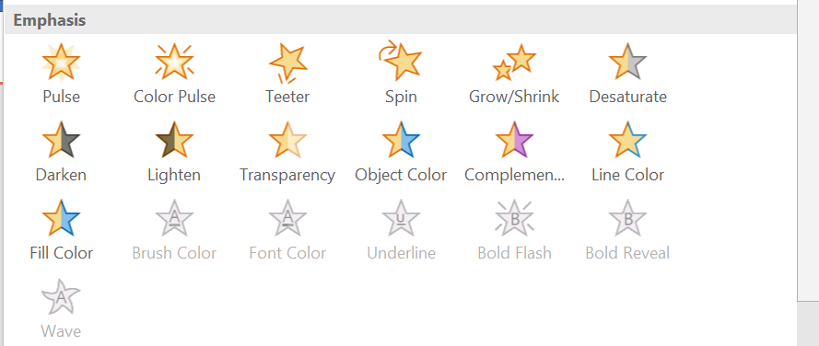
3. Or, all the information can start on the slide. when you make a point you believe is particularly important, you can tap the screen to “emphasize” it.

Slide 5
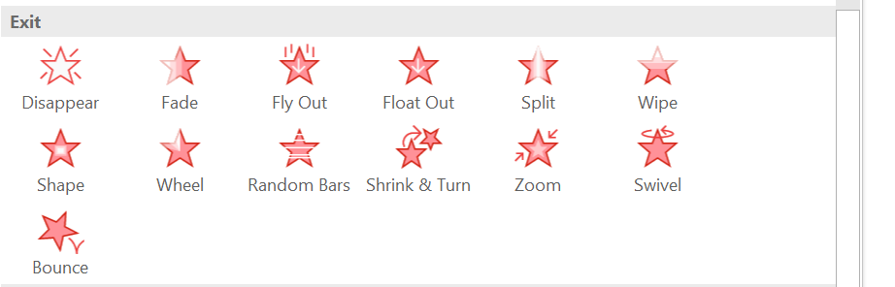
4. For a paper 3, you probably will not need to make things leave the screen, as it will just take more unnecessary time from your presentation. however, it is still an option.

